Slide 1
VaxINFO
Process Book
Creators: Meenakshi Iyer, Jake Reid, Vin Tyagi

Slide 2
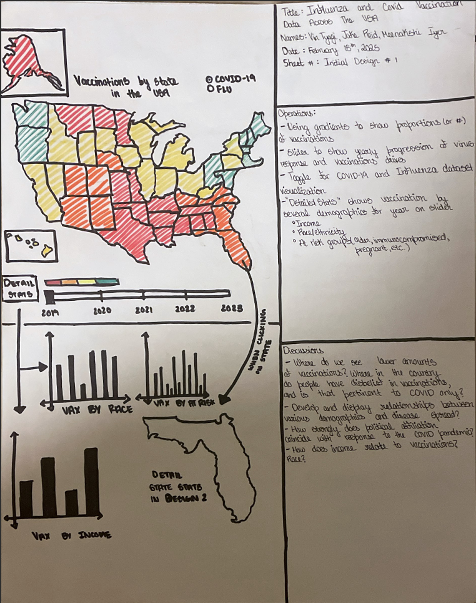
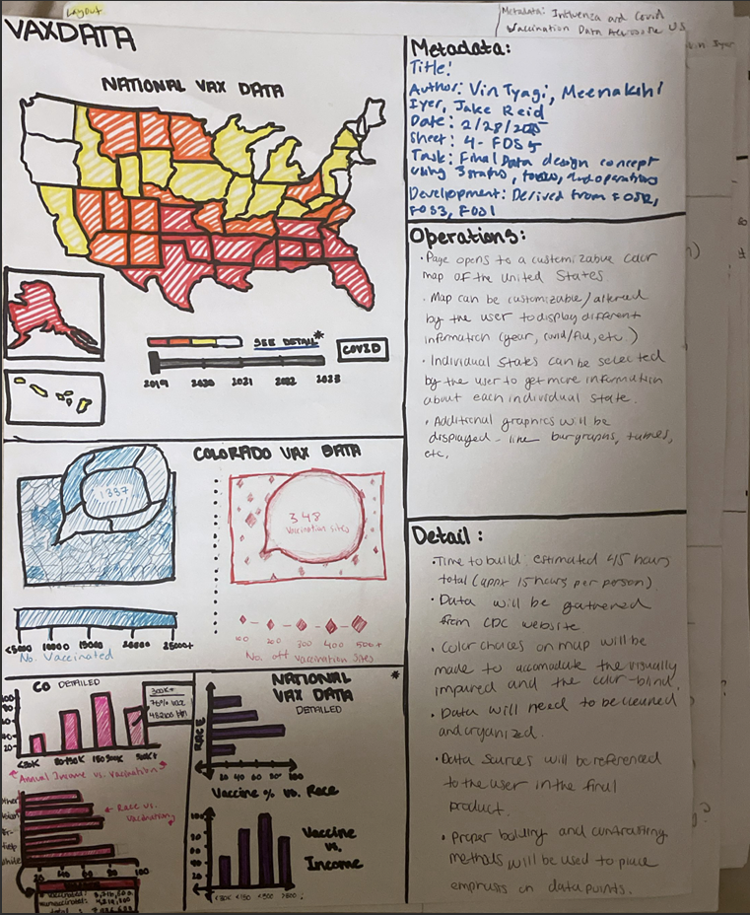
Proposal - Initial Design

Slide 3
APPROACH - INTUITION/MOTIVATION
Our goal was to be able to provide an interactive dashboard that presents recent COVID-19 and flu vaccination data in one spot, making it easier to compare progress and public reception to vaccination efforts to both of the viruses. The dashboard also provides significant insight into how different demographics respond to the two vaccinations.
This data is readily available on the CDC website and includes various visualizations - yet lacks the ability to easily compare vaccination progress among the 2 viruses. Our goal is for VaxINFO to provide comprehensive visualizations that allow users to easily compare COVID and flu vaccination data and provide more insight into trends occurring across the United States.

Slide 4
APPROACH - DESIGN
When thinking of mockups/wireframes and reaching consensus about the looks of the application, we were set on splitting the workload (of the visualization and of the developers), into two hemispheres: nationwide data, and statewide data.
The reasoning behind this was to provide users with a more generalized view of the COVID versus flu response, versus a more localized and small-scale experience in order to see where, within a territory or state, trends of COVID fared better or worse in comparison to the influenza virus.

Slide 5
APPROACH - DESIGN (CONT)
One design approach we made sure to take was the inclusion of a binary color split - such that the whole website will change color in order to reflect flu statistics versus COVID statistics. This allows users with visual impairments or deficiencies to have monochromatic scales when looking at data encoded over maps. This also will visually distinguish to the viewer which data they are currently viewing - minimizing the user’s ability to misinterpret data.
In addition, a design approach we prioritized was interactivity. We can’t display all of our data on one page, we need to give the user choice on what specific datasets / metrics are most important to them, and accessing that data via interaction is key. By providing interactive elements like clicking on specific states or selecting certain metric settings, the overall experience becomes enhanced for the individual user and allows them to explore data that they are personally interested in.

Slide 6
PROCESS - INITIAL TASKS (DATA)
Our goal was to get estimate data from reputable sources, and we used the CDC datasets for Respiratory Virus survey data.
We have to keep in mind that the survey are samples, and may not always accurately reflect actual population parameters. The dataset contains roughly 40,000 tuples, with percentage estimates of how many people of certain demographics, regions, and indicators existed in the sample size.
The flu counterpart contains roughly 60,000 tuples as well, likely because the flu vaccination is not nearly as controversial, and would produce more numerous and more accurate results.

Slide 7
PROCESS - DEVELOPMENT
We are currently thinking of a design scheme with 2 main setups. Our process for how the viewer interacts with our website is to show a nationwide view of the data, with sliders that allow us to view the data timewise.
Hovering over or clicking on specific states on them app will allow us to view statewide data. Additionally, both national and state wide data viewports will provide opportunities for a detailed, demographic centered view of the data set, where users can filter through several demographics and indicators to find detailed information about vaccination efforts.

Slide 8
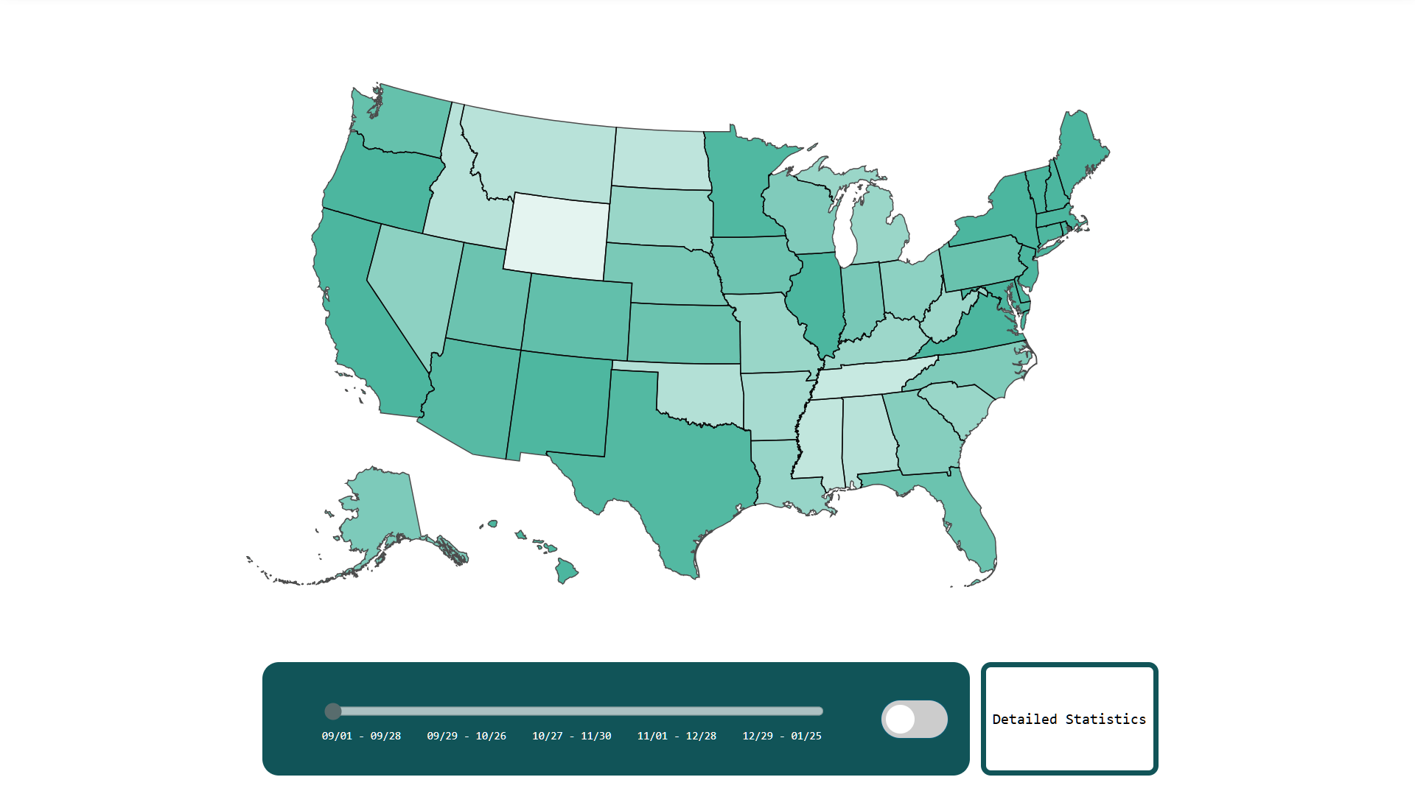
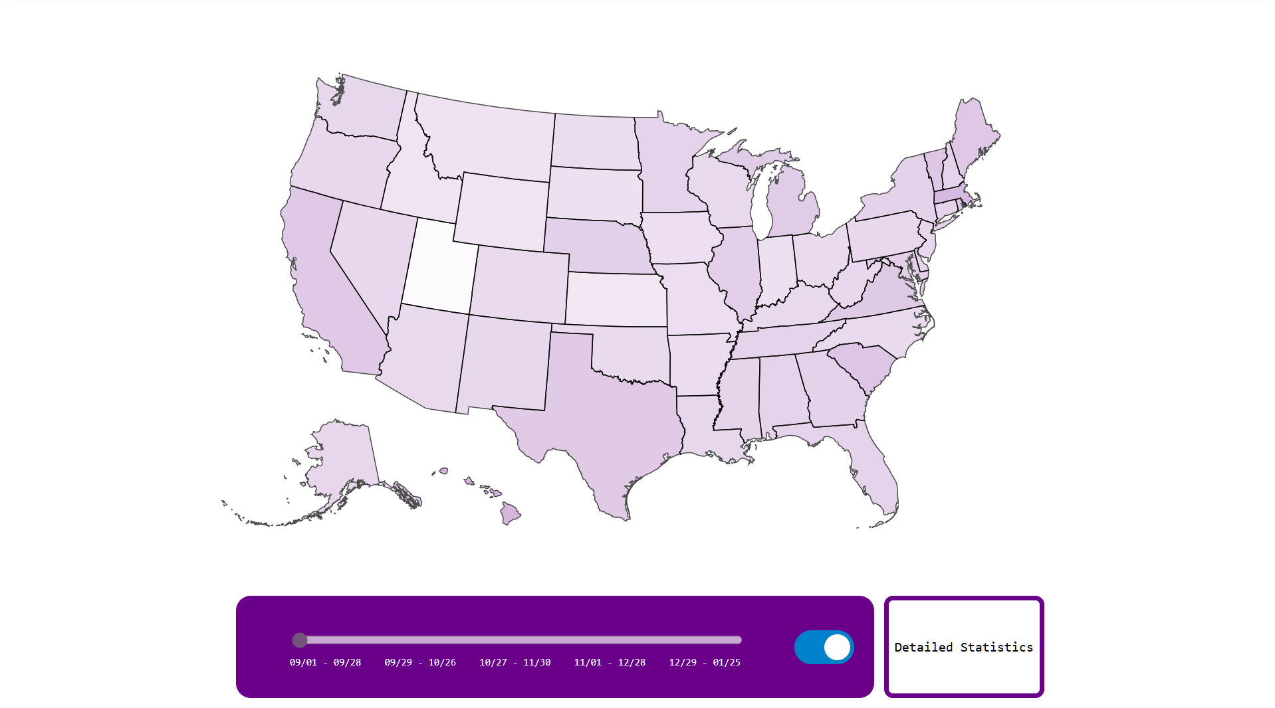
PROCESS - DEVELOPMENT (SO FAR)
Button for detailed statistics on demographics such as race, ethnicity, age, education/literacy,
Sexual orientation, residence in rural or urban areas
State
View when clicking on state (NEXT SLIDE)
Time slider
Flu/COVID Toggle

Slide 9
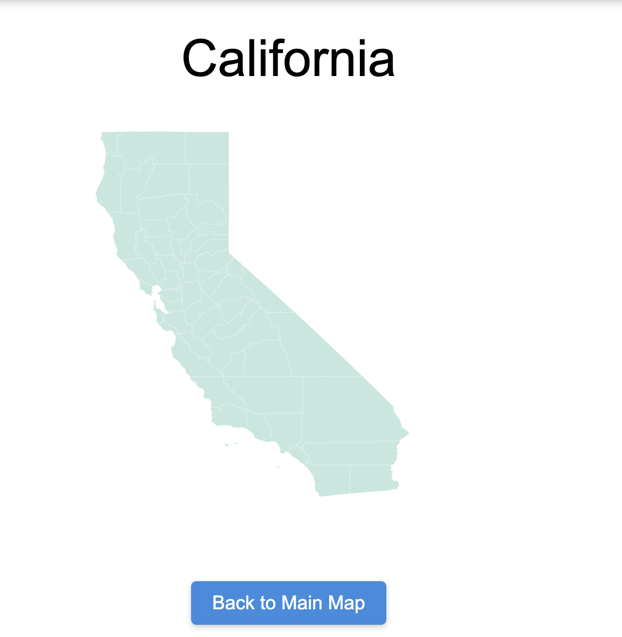
PROCESS - DEVELOPMENT (SO FAR)
STATE VIEW:
Reached when clicking on any state from the national view
County lines to show location
Button to go back to main view

Slide 10
PROCESS - TECH STRUGGLES
Apart from our initial struggles with D3 and acclimating to a new web-app infrastructure, we had, and also are currently having issues with integrating the several different approaches into one cohesive experience.
There are several examples of integration issues:
Making sure that the national view works while supporting state levels data, which is being added
recurring challenge, and something we want to find workarounds for
Verifying, cleaning, and JSON-ifying data
Adding overlay for detailed views, and making sure it works along with national (and now state) view

Slide 11
PROCESS - TECH STRUGGLES (CONT)
Another technical struggle we are facing is utilizing git for version-control. With 3 of us working on the project simultaneously and our git-experience varying, sometimes commits or branch merges can go wrong and other’s code could suddenly break due to oversights by other team members.
We are doing our best as a team to have others review our changes via git approvals before making large changes to the project official. We believe that keeping and staying up to date with advanced VCS principles, such as merges, rebases, PR/MR structure is important, and we are driven to improve our skillset.

Slide 12
PROCESS - OTHER STRUGGLES
While our team has had great communication thus far, we have realized that it has been difficult to find times to meet as the 3 of us have varying schedules and responsibilities. This has made it difficult to have face-to-face meetings where we can work together on developing our project and sharing ideas, so we have had to resort to frequent updates in our team chat.
While this is not ideal, we are doing our best to make time for future team meetings and keep each other consistently updated even when we don’t have the proper time to meet face to face.

